Slide 1
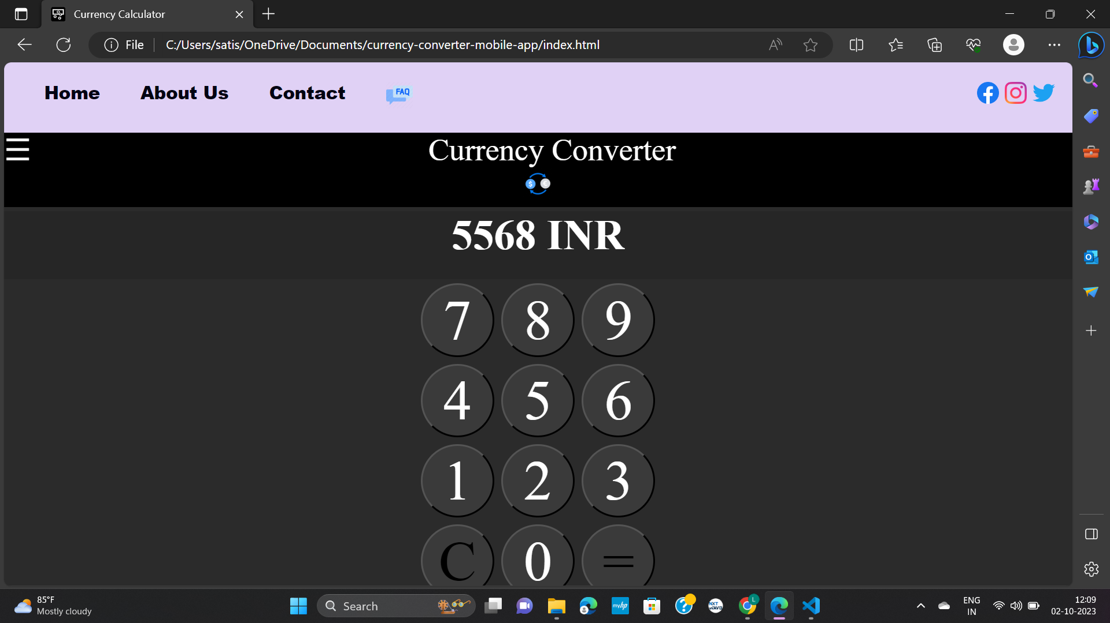
CURRENCY CONVERTER
Track1_Applied_CC_for_Software_Development​
Presented By:
1.Tarigopula Lavanya (20RU1A0551)
2.Sandra poojitha (20RU1A0546)
3.Bojja prathyusha (20RU1A0507)
4.Gulam Mohiddin Khajavali (20RU1A0517)
Guided By: Hrishikesh Mahure

Slide 2
OUTLINE
Abstract
Problem Statement (Should not include solution)
Aims , Objective & Proposed System/Solution
System Design
System Development Approach(Technology Used)
Algorithm & Deployment
Conclusion
References
Future Scope

Slide 3
Abstract
We all know that every country use different currency system, so when person is travel from one place to another or when person transfer the money from one country to another country then everyone needs to convert their currency, by keeping this thought on mind, I develop the currency converter system, so it is very simple to calculate like application. The currency converter has a simple interface in which user can enter the amount and choose the changes.
Such application can be used by any user, but it is mainly useful for business, shares, and finance related areas where money transfer and currency exchange takes place on a daily basis.
In this currency converter app, users are provided with an option to select the type of conversion, i.e. from “this” currency to “that” currency. This simple feature allows users to enter amount to be converted (say currency in Dollars), and display the converted amount (say currency in Euro).

Slide 4
Problem Statement
The goal of this project is to develop a user-friendly and efficient currency converter application that enables users to easily convert between different currencies. The currency converter will provide up-to-date exchange rates and allow users to input an amount in one currency and instantly see its equivalent value in another selected currency. This application aims to be accessible on various platforms, ensuring a seamless and convenient currency conversion experience for users worldwide. Additionally, it will include features such as historical exchange rate tracking, offline mode, and user customization options for currencies and exchange rate sources. The project's primary objective is to simplify currency conversion and provide users with accurate and real-time information to make informed financial decisions when dealing with international currencies.

Slide 5
Proposed Solution
User-Friendly Interface: Develop an intuitive and easy-to-use interface with input fields for the amount, source currency selection, and target currency selection.
Real-Time Exchange Rates: Integrate with a reliable and up-to-date exchange rate API to fetch real-time exchange rates. Regularly update these rates to ensure accuracy.
Conversion Logic: Implement the currency conversion logic, allowing users to input an amount in the source currency and see the equivalent amount in the target currency,
Historical Exchange Rates: Provide the option to view historical exchange rates, allowing users to track currency fluctuations over time.

Slide 6
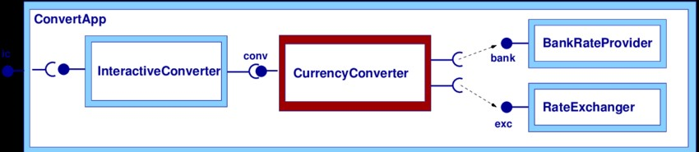
System Architecture

Slide 7

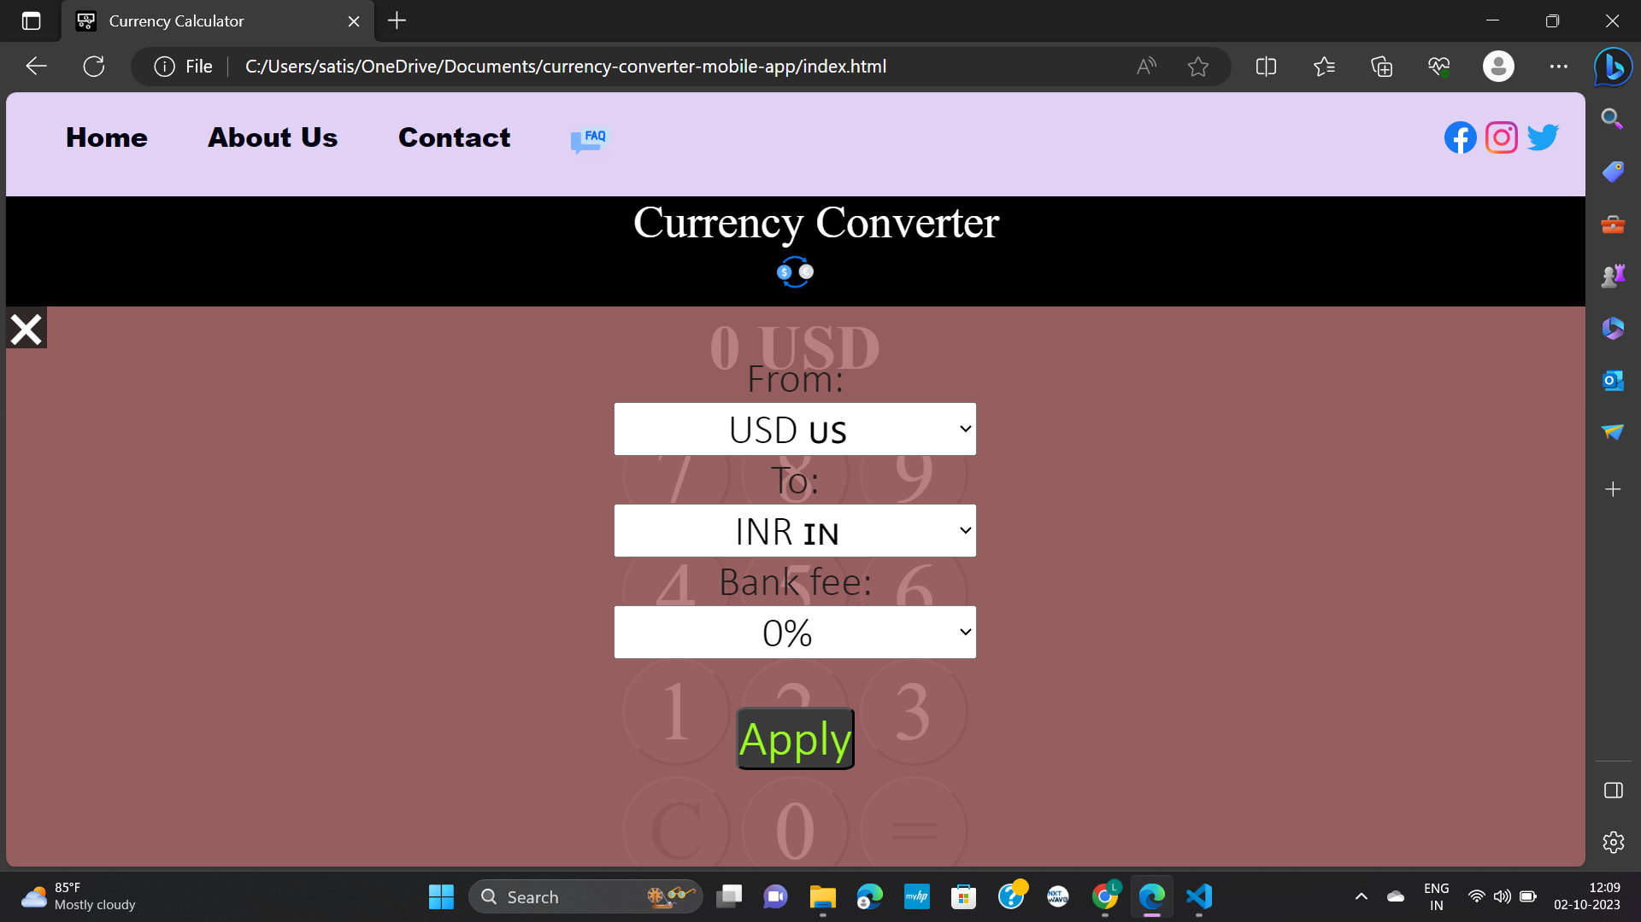
*Implementation :

Slide 8
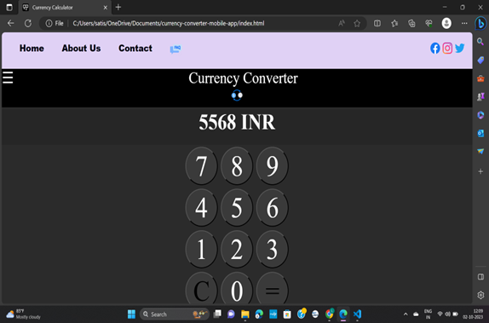
Output:

Slide 9
System development approach
Front-end Development: Implement the HTML, CSS, and JavaScript for the user interface. Ensure it's responsive and user-friendly.
Back-end Development (if required): Develop any server-side components, database integration, and API calls.
Integration: Connect to the selected exchange rate API to fetch the required data.
Testing: Continuously test your application as you develop it to catch and fix issues early.
Choose Hosting: Decide on a hosting platform (e.g., GitHub Pages, Netlify) and deploy your application.
Gather Requirements: Collect detailed requirements from stakeholders, specifying features, user interface design, and any specific functionality like real-time data or historical rates.
Collect Feedback: Continuously gather feedback from users to identify areas for improvement.

Slide 10
Algorithm
Algorithm for currency converter:
Get Exchange Rates Data:Use a reliable source to obtain exchange rate data. This can be done through an API provided by a financial institution or a third-party service. Ensure that you have access to up-to-date and accurate exchange rates.
Validate Input:Check that the source and target currencies are valid and supported by your exchange rate data source.
Calculate Conversion:Use the exchange rate to calculate the converted amount.
Converted Amount = Amount to Convert * Exchange Rate
Display Result:Display the converted amount to the user, including the source and target currencies.You may also want to display the date and time of the exchange rate to indicate how current the conversion is.

Slide 11
Deployment
Deployment of currency converter:
Prepare Currency Converter Project: Ensure that your project is well-structured and organized. You should have at least two files: an HTML file for the structure and a CSS file for styling. Optionally, you can have a JavaScript file for functionality.
Choose a Hosting Platform:There are several free hosting platforms available for static websites. Two popular options are GitHub Pages.
GitHub Pages: If you don't have a GitHub account, create one. Then, create a new repository for your project. Upload your HTML, CSS, and any other assets (e.g., images) to the repository. Go to the repository settings, scroll down to the "GitHub Pages" section, and configure the source branch (typically "main" or "master"). Your site will be accessible.
https://yourusername.github.io/repo-name

Slide 12
Conclusion
In conclusion, a currency converter is a valuable tool that simplifies international financial transactions by providing real-time exchange rate information and enabling users to convert one currency into another quickly and accurately. Whether for personal travel, business transactions, or investment decisions, currency converters play a crucial role in the global economy, facilitating seamless currency conversions and financial planning across borders.
when person transfer the money from one country to another country then everyone needs to convert their currency, by keeping this thought on mind, I develop the currency converter system, so it is very simple to calculate like application. The currency converter has a simple interface in which user can enter the amount and choose the changes.

Slide 13
Reference
HTML and CSS Tutorials: W3Schools: https://www.w3schools.com/
JavaScript for Interactivity: JavaScript.info: https://javascript.info/
Currency Exchange Rate Data: Open Exchange Rates API: https://openexchangerates.org/
API Documentation:Read the API documentation of our chosen exchange rate data provider for details on how to access exchange rate data programmatically.

Slide 14
Future Scope
A currency converter project, although relatively straightforward in its core functionality, can have several future scope opportunities to enhance its features and usefulness. Here are some potential future scope ideas to consider:
Real-Time Exchange Rates: Expand the project to fetch real-time exchange rates from a reliable API. This ensures that users always get the most up-to-date conversion rates.
User Accounts: Implement user registration and accounts, allowing users to save their conversion history, favorite currencies, and personalized settings.
Offline Access: Develop a mobile app version that allows users to access the currency converter even when they're offline, with the option to update rates when they regain connectivity.
Currency Alerts: Allow users to set up alerts for specific exchange rate thresholds. They would receive notifications when the rates meet their criteria.
Feedback Mechanism: Implement user feedback mechanisms to collect suggestions and comments for continuous improvement.

Slide 15
THANK YOU

